Slide 1


FOOD TUNK Q-Commerce Website
Revolutionizing Food Delivery Through Q-Commerce
AHMED ALI

Slide 2
THE PROBLEMS
Food delivery is often slow, especially when customer needs quick meal or groceries
01
Limited customization options and ineffiecent cart system frustrate users
02
Lack of a seamless user experience for browsing and purchasing food items dynamically
03

Slide 3
THE SOLUTION
A Q-commerce website for food delivery that ensures faster delivery and a user-friendly interface.
01
Integrated shopping cart with quantity adjustment and total price calculation
03
Dynamic product menus powered by sanity for real-time updates
02

Slide 4
Key Features
Dynamic Routing:
Custom product menu pages based on [slug].
Shopping Cart:
Add-to-cart functionality with real-time quantity and price updates.
User-Friendly Interface:
Built with Next.js and Tailwind CSS for speed and design.
Blog Section:
Informative blogs about food trends and recipes.
API Integration:
Real-time product and order management.

Slide 5
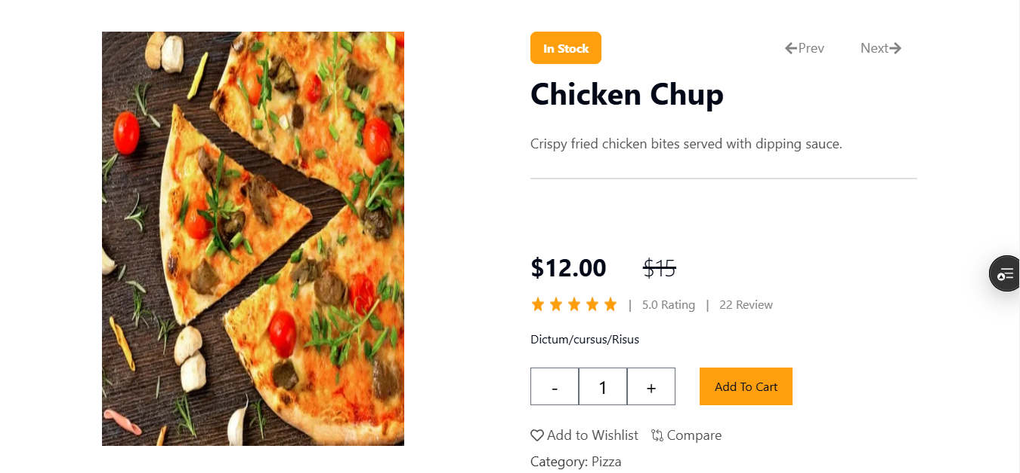
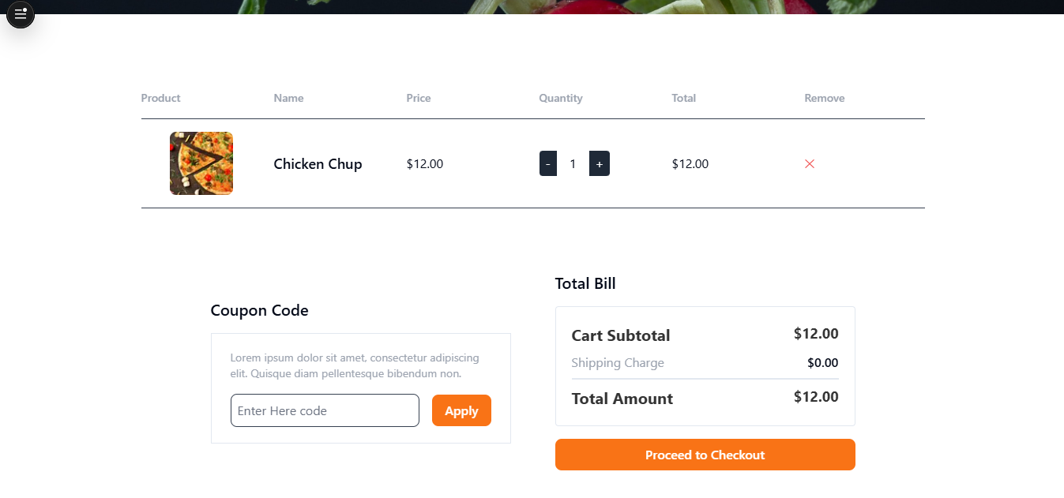
Dynamic Routing
Cart Page

Slide 6
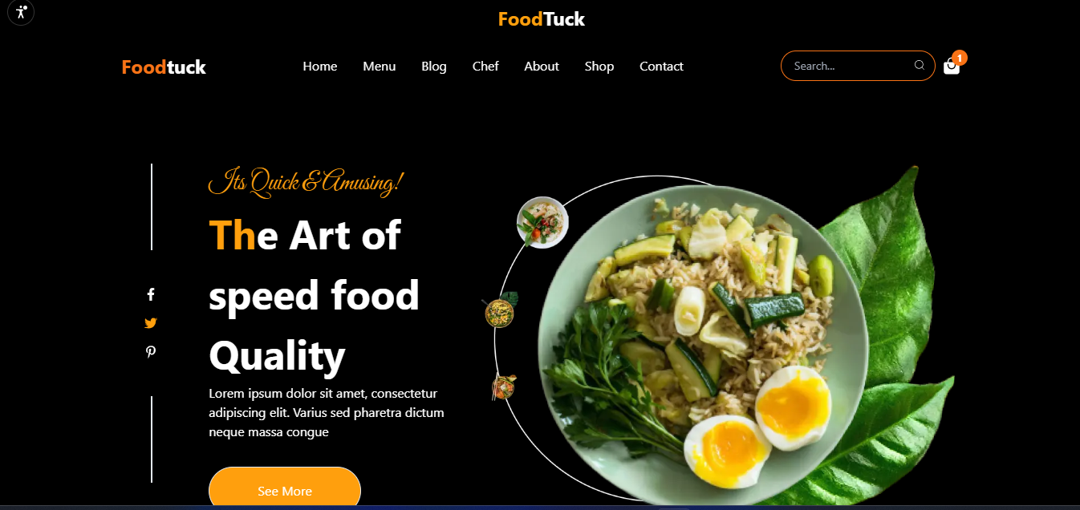
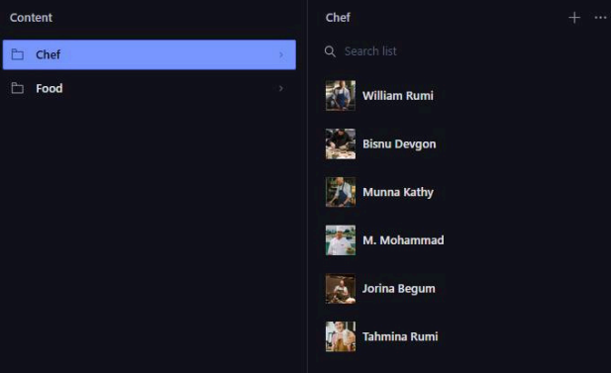
TECH STACK
FRONEND
Frontend: Next.js, Tailwind CSS
Backend: Sanity for CMS
Hosting: Vercel
Database: Real-time data fetched via APIs
SANITY

Slide 7
Business Plan
Revenue Streams:
Delivery fees
Premium subscription for faster delivery
Commission from food partners
Target Audience:
Busy professionals
Students
Families looking for convenient food delivery

Slide 8
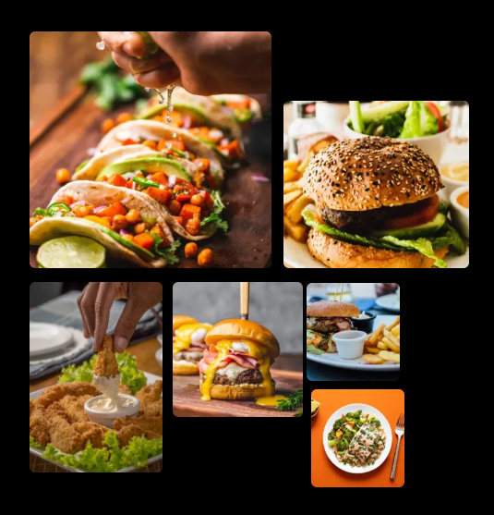
FUTURE VISION
Scale AI-driven meal recommendations: Utilize customer data to suggest meals based on preferences, dietary restrictions, and purchase history.
Partner with local restaurants: Build exclusive collaborations to offer unique discounts and food menus.
Introduce subscription-based meal plans: Weekly or monthly meal kits for customers seeking convenience.
Launch a mobile app: Ensure customers can access the platform anytime, anywhere for better usability and engagement.

Slide 9

MEET THE DEVELOPER
Ahmed Ali: Full Stack Developer
Expertise in Next.js, Tailwind CSS, and Sanity CMS.
Passionate about creating intuitive web interfaces.
Experienced in building responsive and scalable web solutions.

Slide 10
THNAK YOU!
URL: https://food-tunk.vercel.app/
EMAIL: ahmedsiridab1@gmail.com
LinkedIn: https://www.linzkedin.com/in/ahmed-ali-160b2a313/

